Slide 1
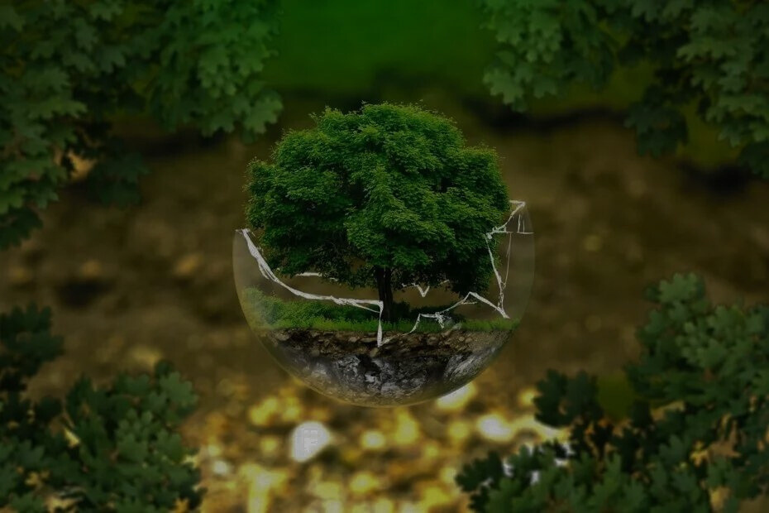
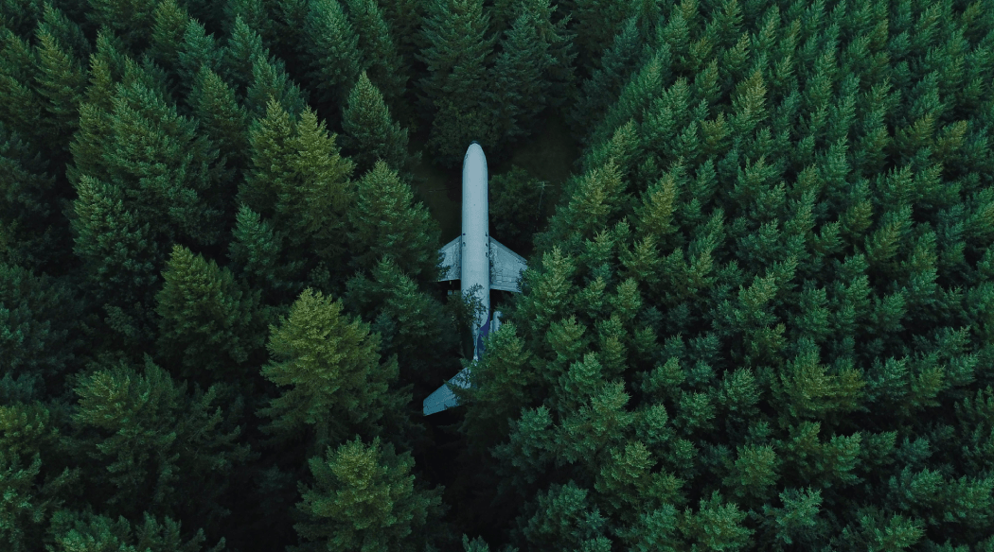
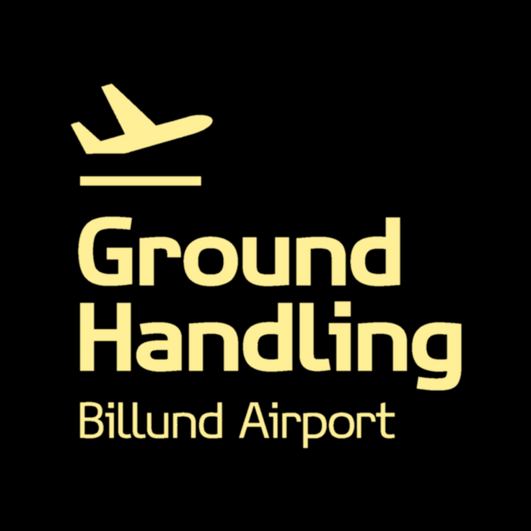
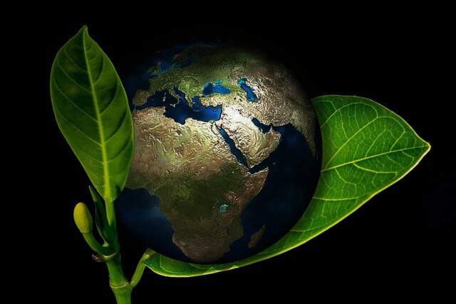

GREENER TRANSPORT AND RESOURCE MANAGEMENT
CUSTOMER DAY
3. OCTOBER 2024
  Electric cars and bikes for transport.
  No printed lists for hand luggage.
  SAF information at the gate.
DIGITALISATION AND PAPER REDUCTION
  Switching off lights and screens after departure.
  Using electric towing trucks.
  Cleaning with less water and fewer bags.
  Fewer boarding passes printed.
  Almost paperless arrival process.
  Propose digital boarding passes via email.
  Eliminate unnecessary loadsheet printing.
ENERGY EFFICIENCY AND
sustainable operation

Slide 2

KL/GHBA Sustainable Initiatives
KL/GHBA has implemented a number of concrete initiatives to reduce environmental impact and promote sustainable working practices across different departments.

Slide 3
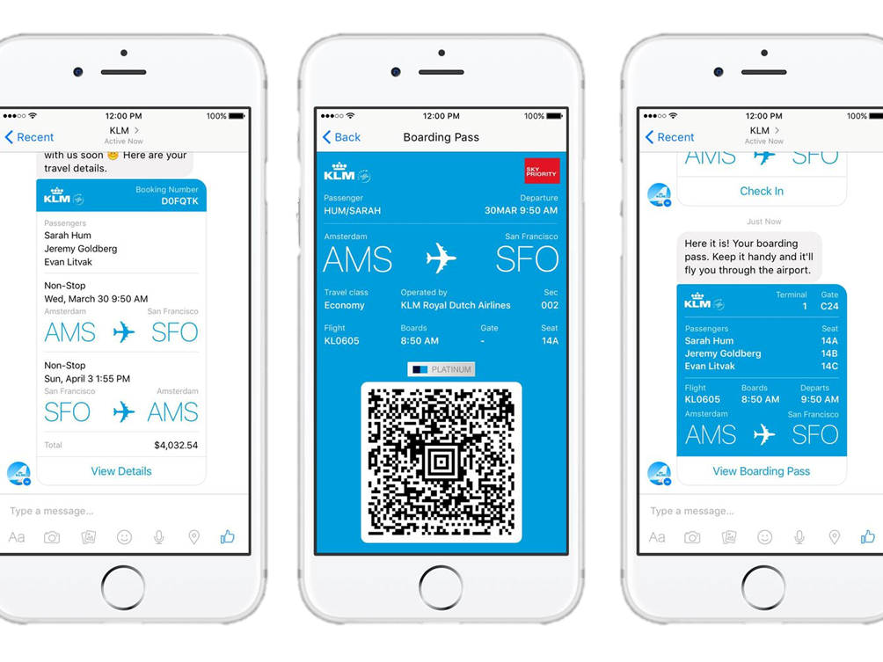
Digital solutions in the Passenger Handling
Digital boarding pass
Focus on encouraging passengers to use digital boarding passes, which has significantly reduced paper consumption.
Energy savings
Lights and screens are switched off immediately after departure to minimise energy consumption.
Sustainable Fuels
SAF (Sustainable Aviation Fuel) information is provided at the gate to raise awareness of green fuel solutions.

Slide 4
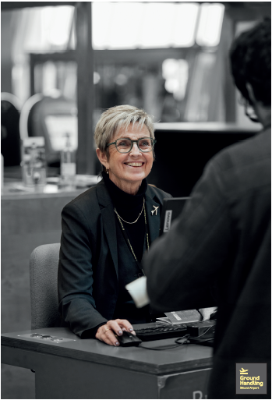
Environmentally friendly workflows
Paperless Arrivals KL is digitalised, especially in the arrival process, supporting a greener experience for passengers. | Electronic gate process Printed lists are no longer necessary and manual handling of hand baggage contributes to environmentally friendly workflows. | Reduced paper waste Proposals to send boarding passes directly to passengers' email can further reduce paper consumption.

Slide 5
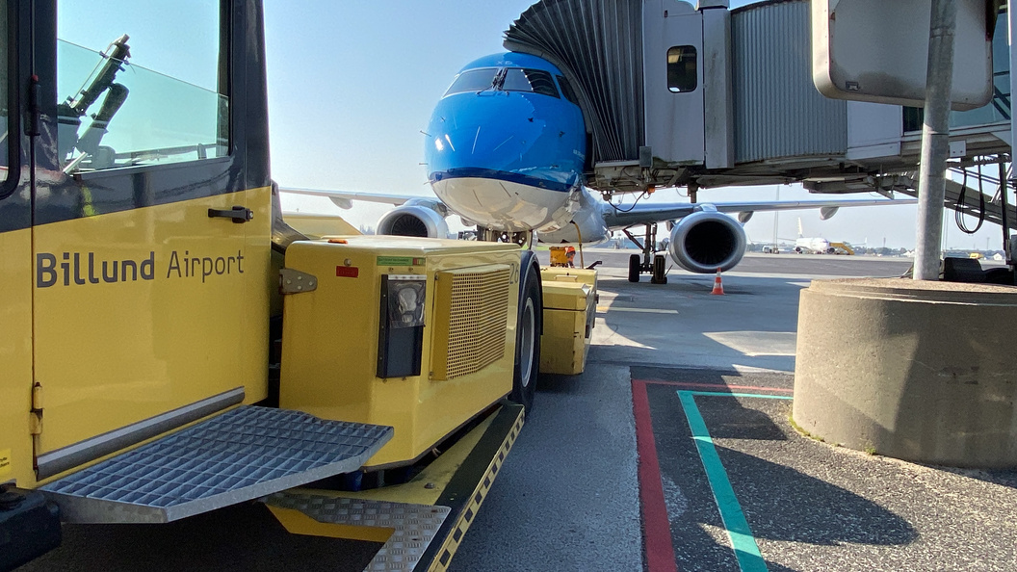
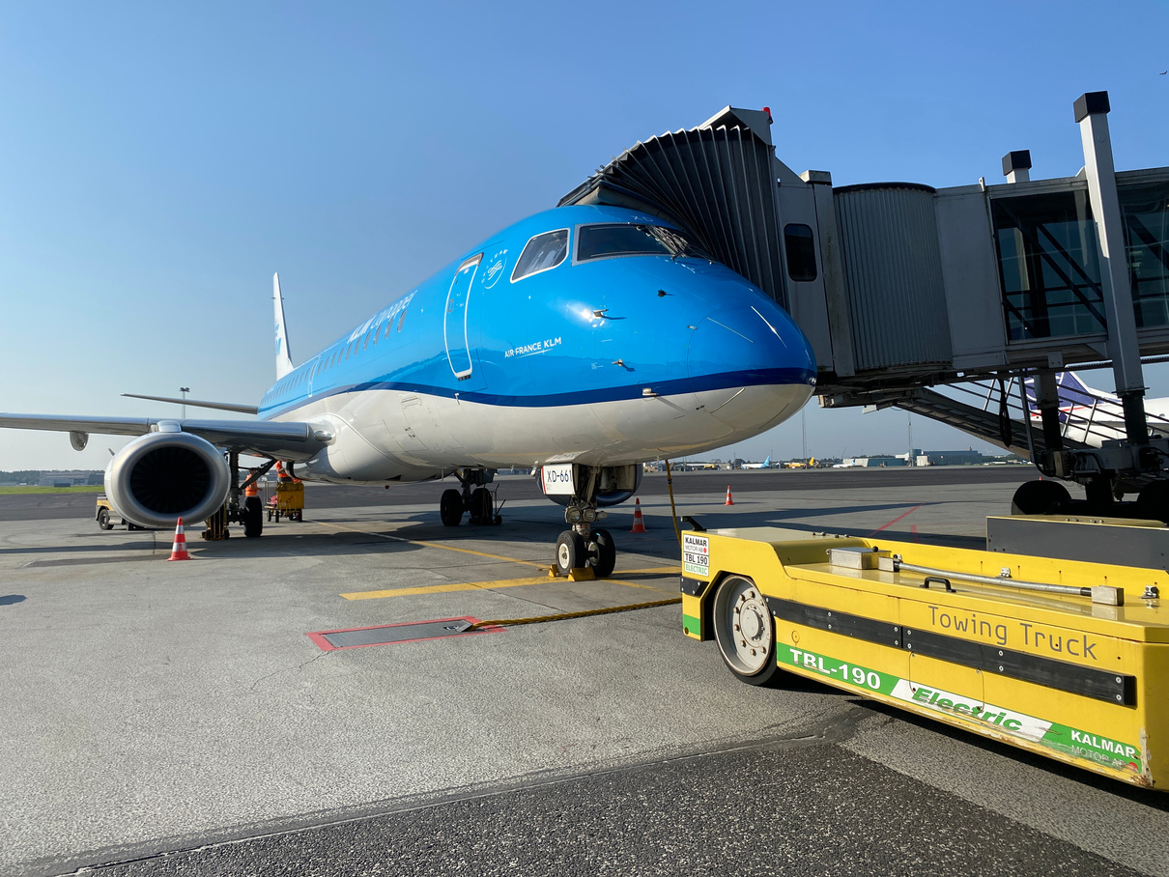
Sustainable solutions in Ramp Handling
1
Electric Towing Trucks
Electric towing trucks are used on all departures except E75, reducing dependence on fossil fuels.
Electronic Systems
Several electronic solutions, such as linder, power stow and electronic baggage handling, have been implemented.
Reduced carbon footprint
Employees are transported between sites in electric cars or by bike, further reducing the carbon footprint.
2
3

Slide 6
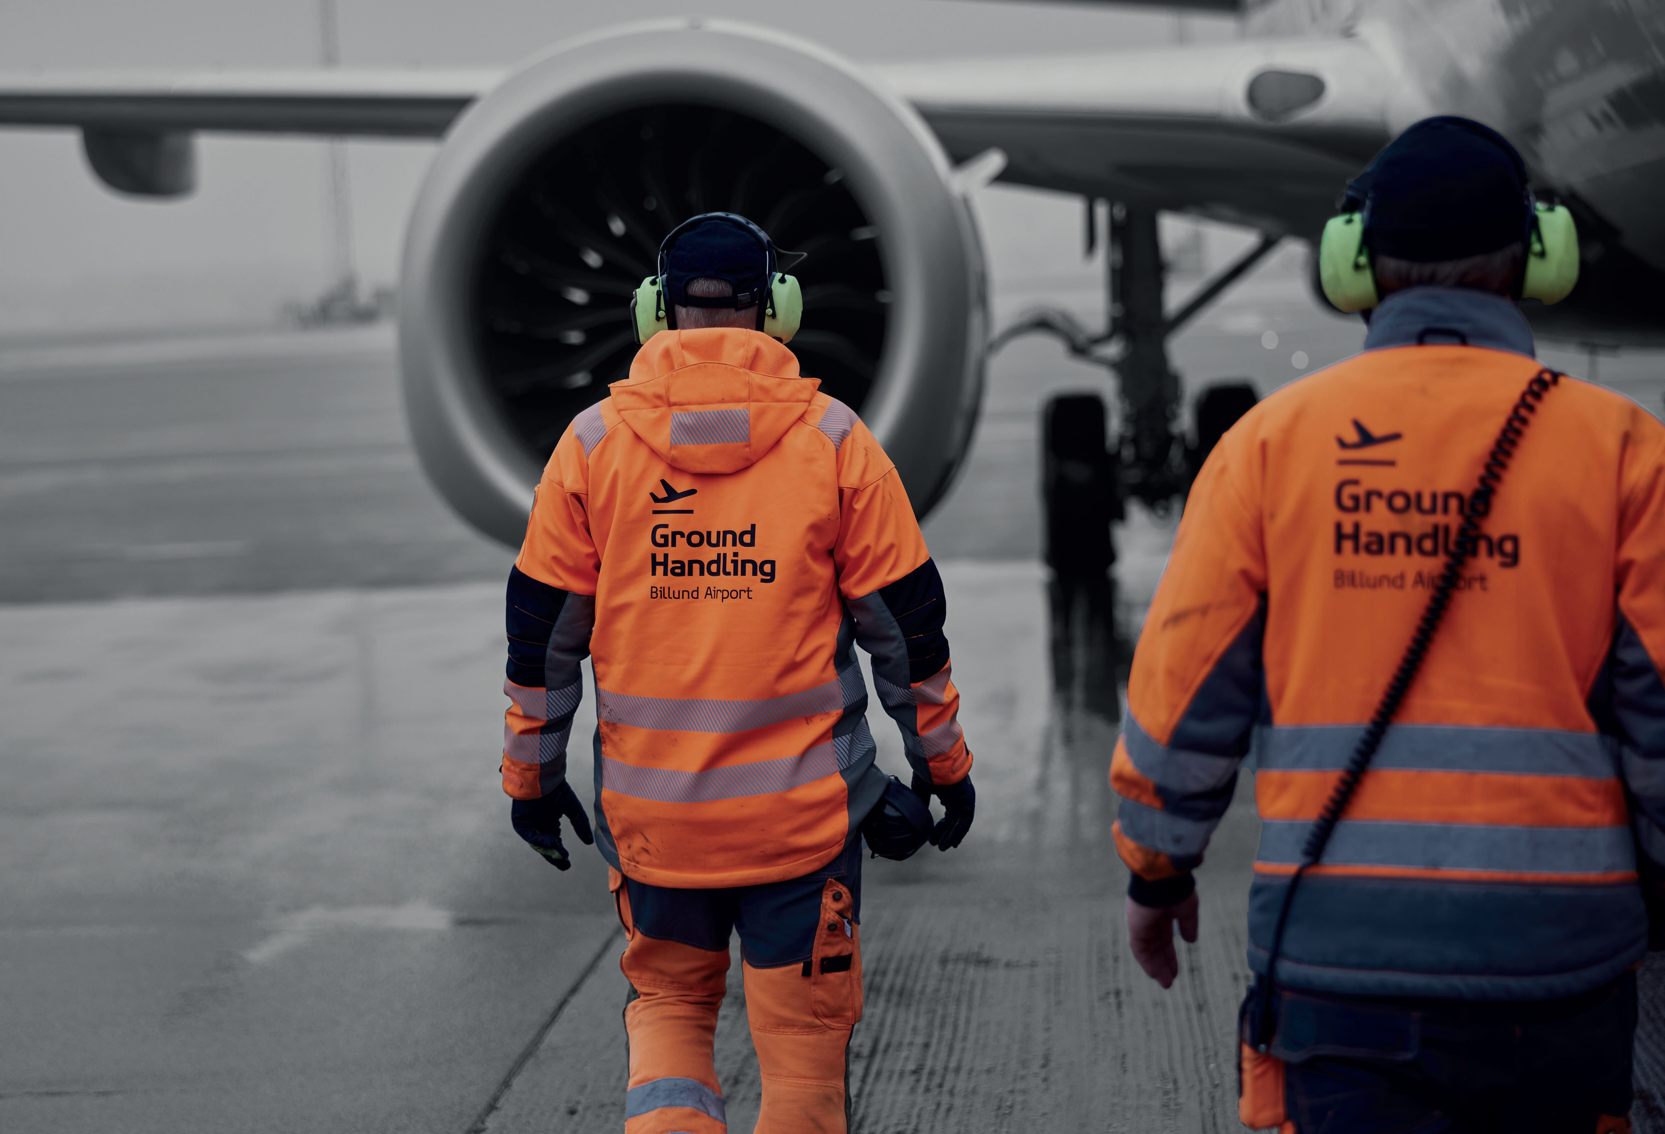
Sustainable cleaning methods
1
2
3
Reduced water consumption
Moist cloths are used more effectively for cleaning to reduce water consumption.
Optimised waste management
Waste is collected in one bag instead of several, optimising waste management.
Green transport
Employees are transported between sites in electric cars or by bike.

Slide 7
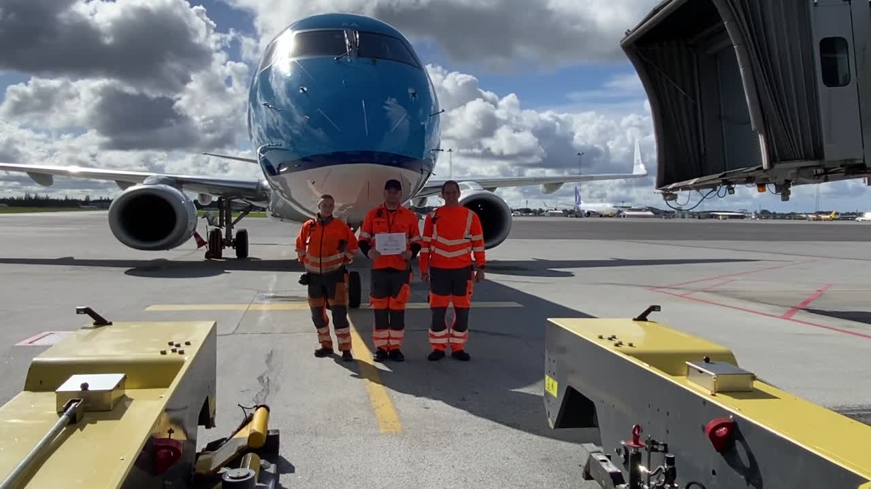
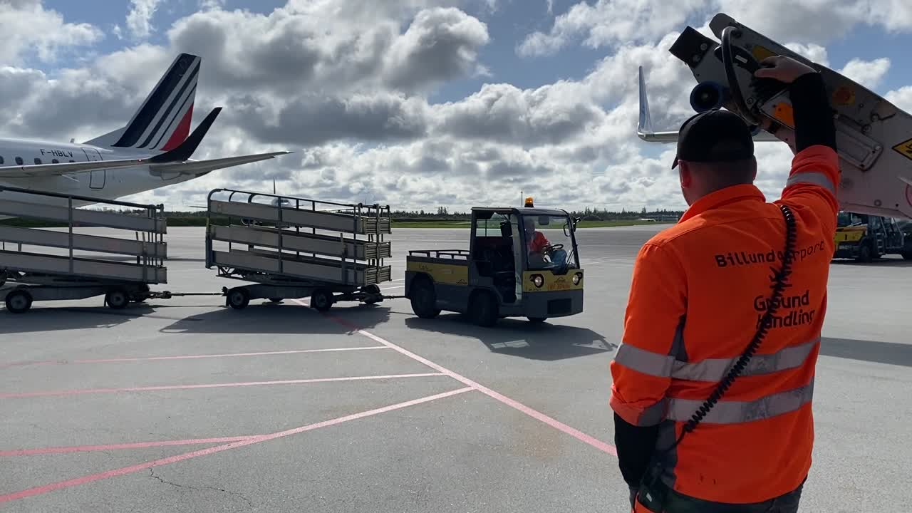
KL/GHBA green focus
Digitalisation
KL is highly digitalised, which supports environmentally friendly operations.
Reduced resource consumption
Numerous initiatives reduce paper, energy, water and carbon footprint.
1
2
3
Future-proofing
Continuous improvements and new initiatives ensure continued environmental focus.

Slide 8
